Slide 1
HOSTED DESKTOPS FOR GROWING BUSINESSES

Slide 2
PRESENTATION OVERVIEW
What is a Hosted Desktop?
How does it work?
Features
Benefits
Hosted Desktop pricing

Slide 3
HOW DOES THE HOSTED DESKTOP WORK?
WHAT IS A HOSTED DESKTOP?
A Hosted Desktop gives you the freedom to work from anywhere. Think of it as your desktop computer with all the software and files you normally keep and use with the added bonus of being able to access it from any computer.

Slide 4
Not only can you access your personal desktop from any standard desktop computer, you can also access your desktop from any operating system and a full range of modern mobile devices.

Slide 5
HOW DOES THE HOSTED DESKTOP WORK?
HOW DOES THE HOSTED DESKTOP WORK?
Just as normal, you can write documents with Microsoft Word, Excel, PowerPoint, etc., send emails and do everything that you normally do with your current Windows-based machine.

Slide 6
Instead of storing your desktop on a computer in your office, we host it on hugely powerful computers in an offsite data centre. This is often referred to as “the Cloud”.

Slide 7
Don’t worry. It is still a Windows operating system - so there’s nothing new to learn as nothing changes.

Slide 8
All your data is securely stored in UK-based data centres.

Slide 9
There are also added benefits which include Version control.

Slide 10
And restoration of backup files.

Slide 11
You can quickly and easily add and remove users.

Slide 12
BENEFITS OF THE HOSTED DESKTOP
Pay for what you want, when you want, on a monthly basis.

Slide 13
There are NO long term contracts.

Slide 14
Perfect for a flexible workforce.

Slide 15
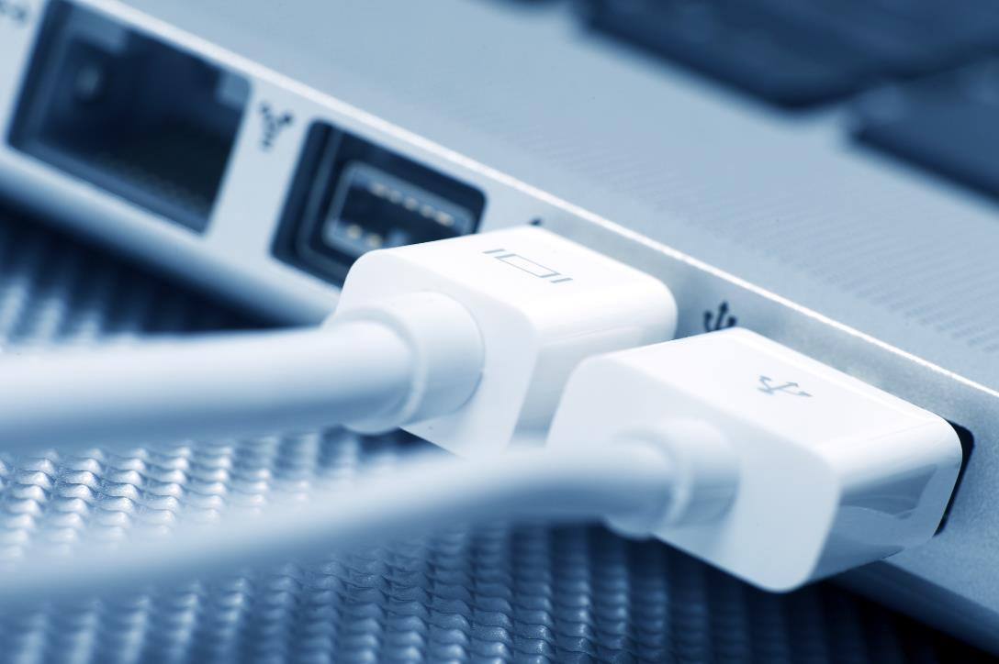
FULL FEATURES
Windows 8 style Hosted Desktop
Choice of Microsoft Office or Open Office
USB redirection
Network and local printing
Secure encrypted connections
Fully automated daily backup
Anti-virus included
99.99% uptime guarantee
Fast graphics acceleration
Full audio support
Complete isolation from other users

Slide 16
FULL BENEFITS
Full desktop experience
Flexibility - work anywhere in the world
Save money
Save space
Reduce your carbon footprint
No data is stored on your device, iPad, PC, etc.
Offsite backup
No fixed-term contract
Full technical support included as standard
Highly scalable solution

Slide 17
PRICING
No long term contract
30 day rolling contract
No capital outlay
Monthly fee reduces if your user-base reduces

Slide 18
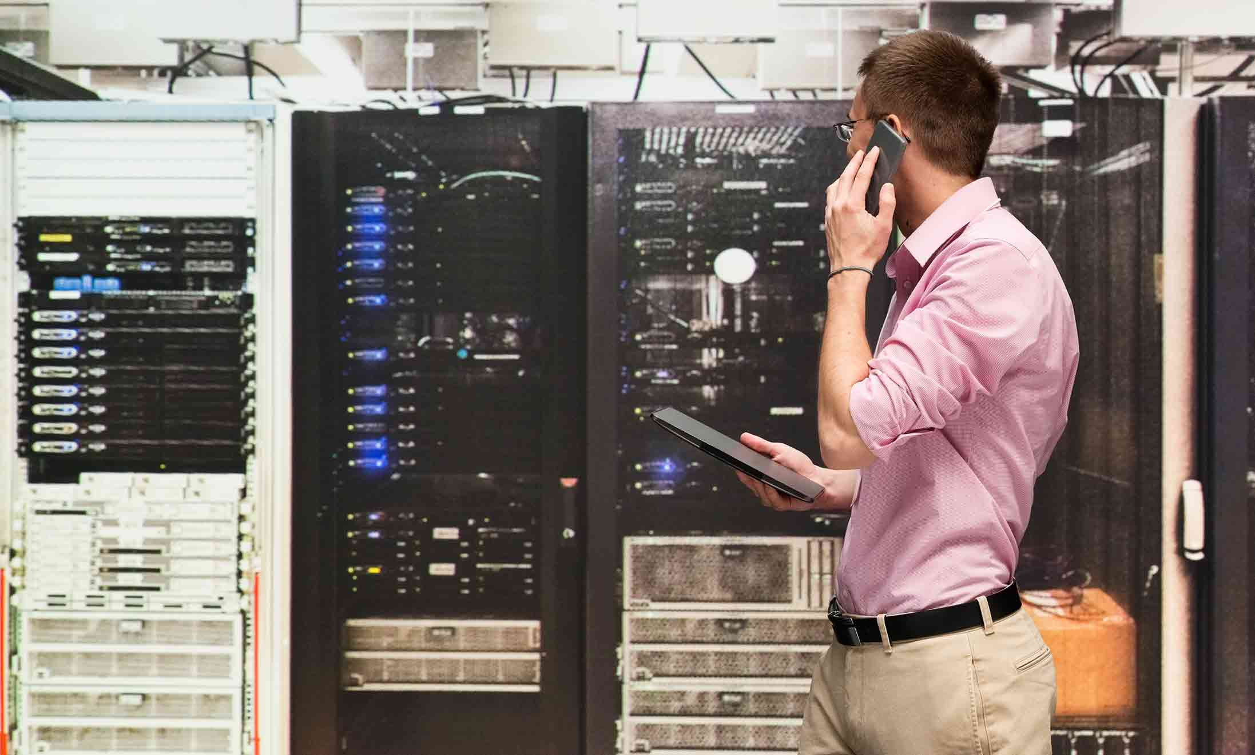
NEXT STEPS
Test drive a demo of the hosted desktop
Discuss application requirements
Discuss testing & rollout-out strategy
Receive proposal
Gain management buy-in
Parallel test and launch!

Slide 19
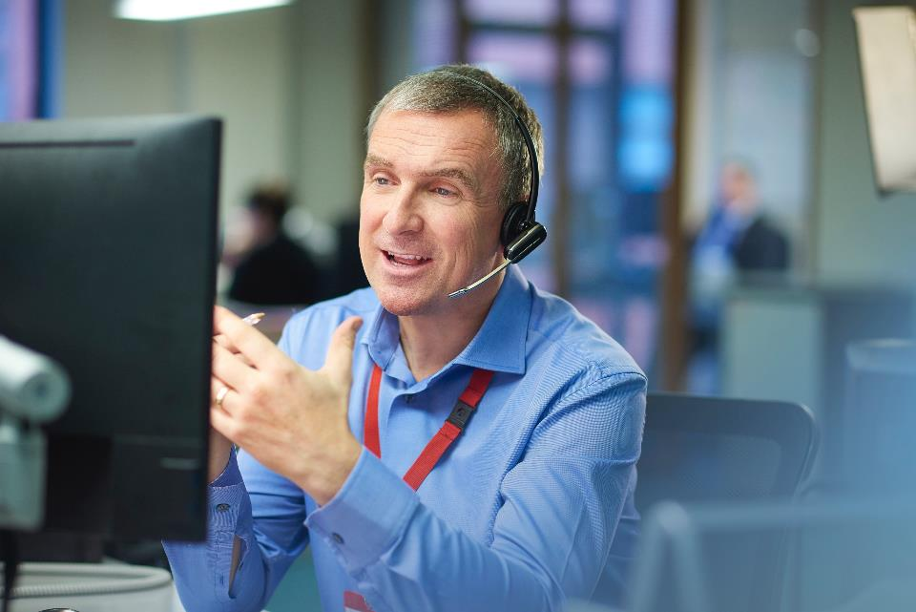
0800 832 1852
operationtechnical.com
sales@operationtechnical.com

